Slide 1
Homework
Week 2

Slide 2
Question 1
5 x ? + 15 = 85
5 x ? = 70
? = 14
ANSWER - C
(-15)
(÷ 5)

Slide 3
Question 2
15 ÷ 12
= $1.25
ANSWER - B

Slide 4
Question 3
1, 5, 13, 29
1 x 2 + 3 = 5
5 x 2 + 3 = 13
13 x 2 + 3 = 29
ANSWER - 29

Slide 5
Question 4
y = 4x + 3
y = 4 x 2 + 3
y = 8 + 3
y = 11
ANSWER - 11

Slide 6
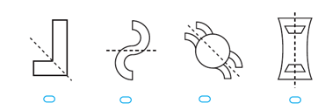
Question 5
ANSWER - D

Slide 7
Question
Square Pyramid
ANSWER - B

Slide 8
Question 6
A = l x w
= 20 x 5
= 100 cm²
A = l x w
= 25 x 10
= 250 cm²
ANSWER - B
A = l x w
= 15 x 15
= 225 cm²
A = l x w
= 35 x 5
= 175 cm²

Slide 9
Question 7
2:38pm to 3:11 pm is 33 min
ANSWER – 33 min

Slide 10
Question 8
60 – 8 – 22 – 13 = 17
OR
60 – (8 + 22 + 13) = 17
Answer - 17

Slide 11
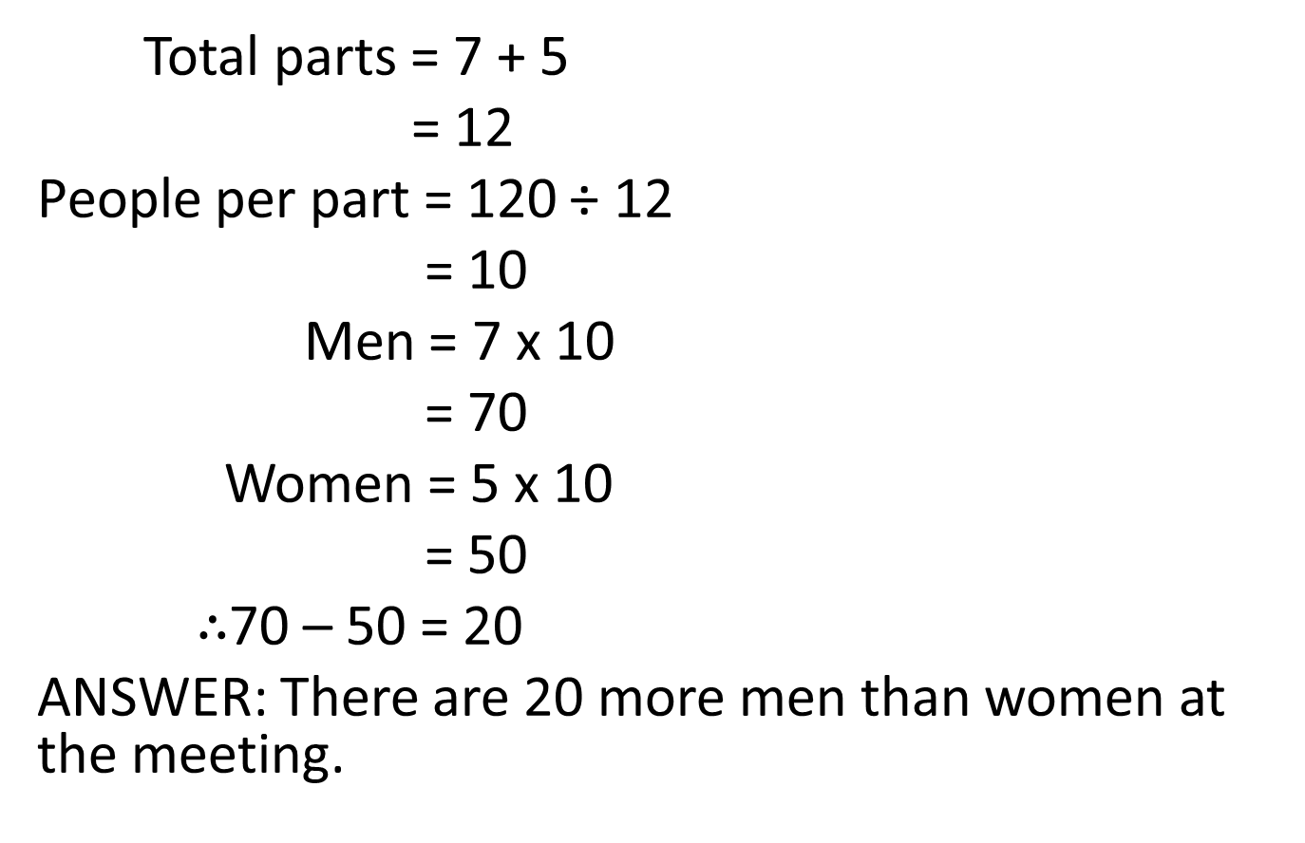
Question 9

Slide 12
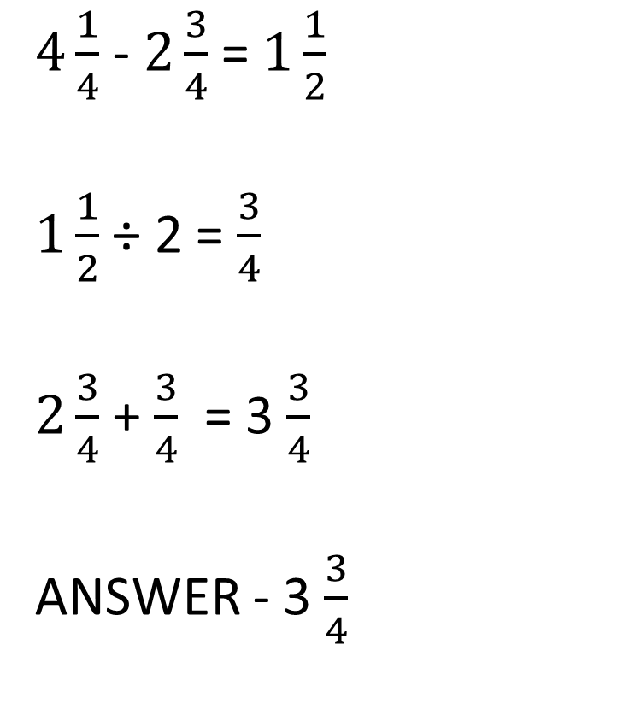
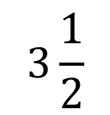

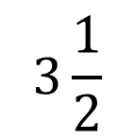
Question 10

Slide 13
Question 11
15 mm = 1.5 cm
9 + 1.5 = 10.5 cm
ANSWER - C

Slide 14
Question 12
Surface Area of cube = 6l²
= 6 x 7²
= 294 cm²
ANSWER - 294 cm²

Slide 15
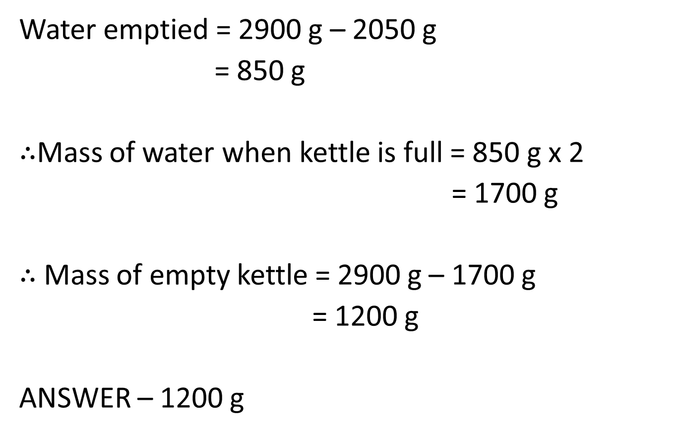
Question 13

Slide 16
Question 14
17 sticks
4 pentagons
Number of sticks = 4 x 4 + 1
= 17
ANSWER - D

Slide 17
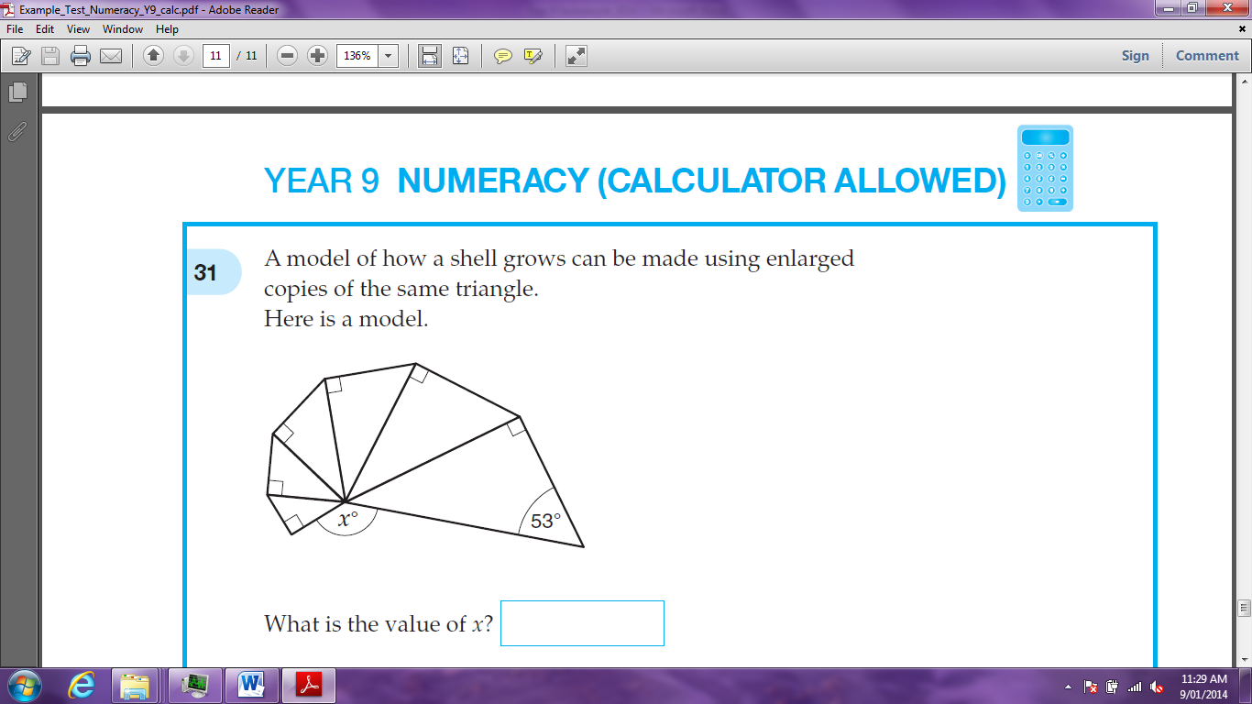
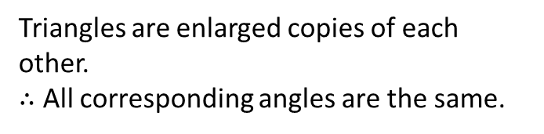
Question 15
180° - 90° - 53° = 37°
37° x 6 = 222°
x = 360° - 222°
= 138°

Slide 18
Question 16
5 sides = (5 – 2) x 180° ÷ 5
= 108° (Not our answer)
7 sides = (7 – 2) x 180° ÷ 7
= 128.6° (Not our answer)
9 sides = (9 – 2) x 180° ÷ 9
= 140°
ANSWER - 9

